Slide 1
DeepPET: A deep encoder–decoder network for directly solving the PET image reconstruction inverse problem
Häggström, Ida, C. Ross Schmidtlein, Gabriele Campanella, and Thomas J. Fuchs. Department of Medical Physics, Memorial Sloan Kettering Cancer Center,
Medical image analysis 54 (2019): 253-262.
Presenter: Zong Fan

Slide 2
Agenda
Motivation of research
Methods
Experiment results
Conclusion & Critique

Slide 3
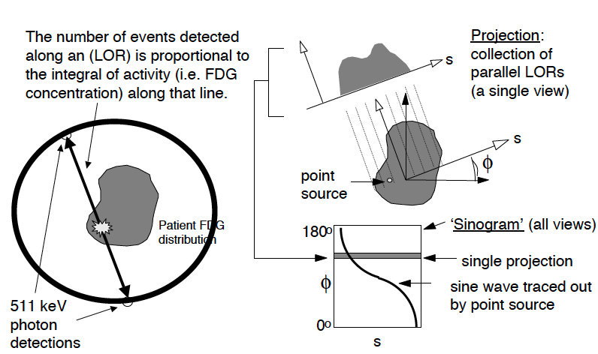
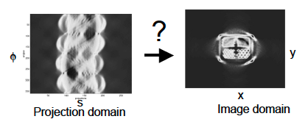
1. Motivation of Research
Principle of PET Imaging
Adam Alessio, Introduction to PET Image Reconstruction, 2007

Slide 4

Conventional reconstruction algorithms
Inverse problem:
Analytical methods: filtered back projection (FBP)
Pros: easy to compute and fast
Cons: cannot model noise
Iterative methods: ordered subset expectation maximization (OSEM)
Pros: reduce noise and consider effects including scatter, attenuation, etc
Cons: Slow and hard to analyze because of non-linearity
Regularized methods: maximum a posteriori (MAP)
Pros: no need post-smooth, more accurate
Cons: slower, and have more variables to adjust

Slide 5
2. Methods
Use deep network as reconstruction function:
End-to-end learning: directly learn inverse of pysical model, statistic model, and the regularization.
Computational efficiency
Workflow: 1. Generate dataset of PET-to-sinogram images
2. Train a deep network with generated data

Slide 6
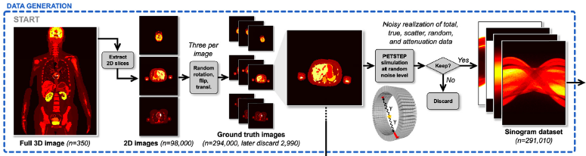
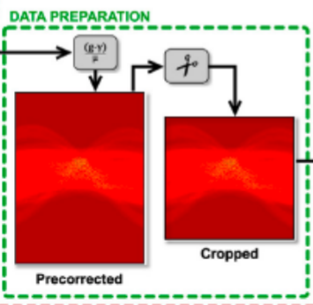

Dataset Generation
1. 3D XCAT digital phantom
- 350 patients with 280 slices
- adjust parameters to simulate the variance in patients (position, organ shape and size, gender, tracer activity)
2. PETSTEP simulator
- model GE D710/690 PET/CT scanner with 288 angular x381 radial bins
- introduce independently distributed scatter, random, and attenuation factors
3. Precorrect sinogram data as input of DeepPET net
-
μ,γ is attenuation and random and scatter effects.
- crop empty corner (first and last 56 radial bins)

Slide 7
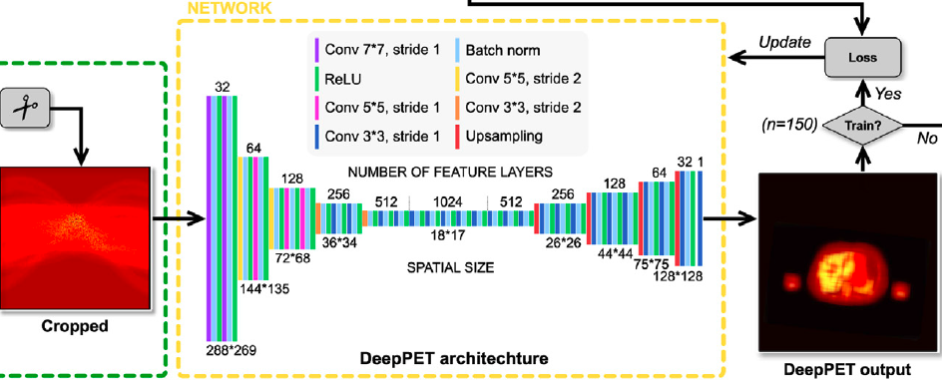
DeepPET Training
GT PET image
Input: precorrected sinogram with shape (288x269)
Network: encoder-decoder structure with 4 downsampling and 4 upsampling
Output: PET image with shape (128x128)
Dataset: 245 patient for training, 52 for validation, 53 for testing
Loss function: MSE
Optimizer: Adam

Slide 8
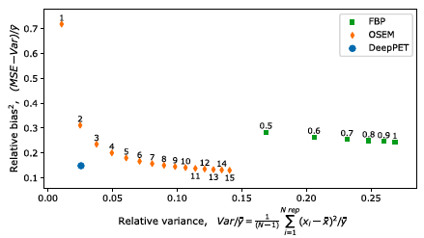
3. Experiment Results
Average bias versus noise of different methods
Notes:
The relative variance (RV) is a measure of error, or how much the “noise” of a data point or set of data points can vary
MSE includes both variance and bias

Slide 9
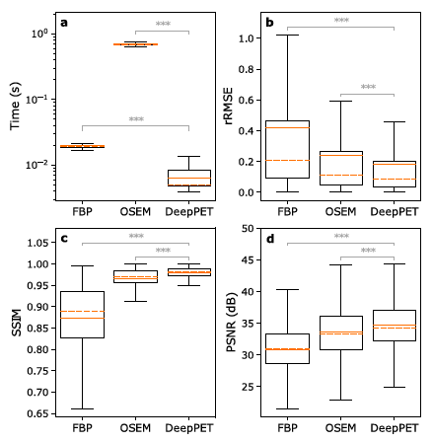
DeepPET has faster and superior performance
 | DeepPET | FBP | OSEM
Time(ms) | 6.47 | 19.2 | 687
rRMSE | 0.60 | 0.92 | 0.67
SSIM | 0.98 | 0.87 | 0.97
PSNR | 34.69 | 30.85 | 33.59
Improvement is significant via one-way ANOVA test with Bonferroni correction

Slide 10
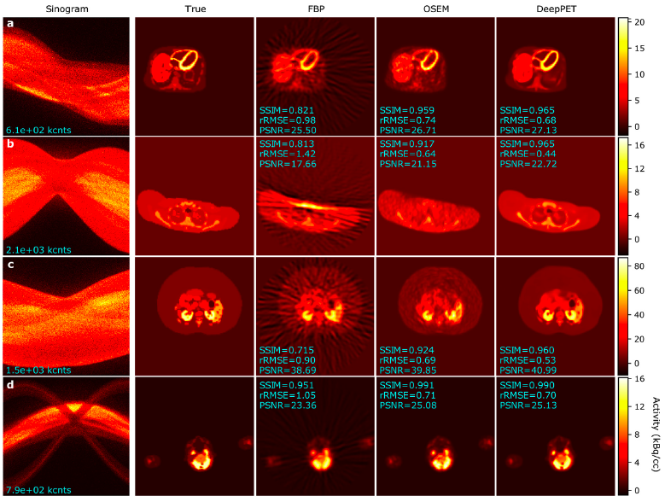
Visualization of Phantom Data

Slide 11
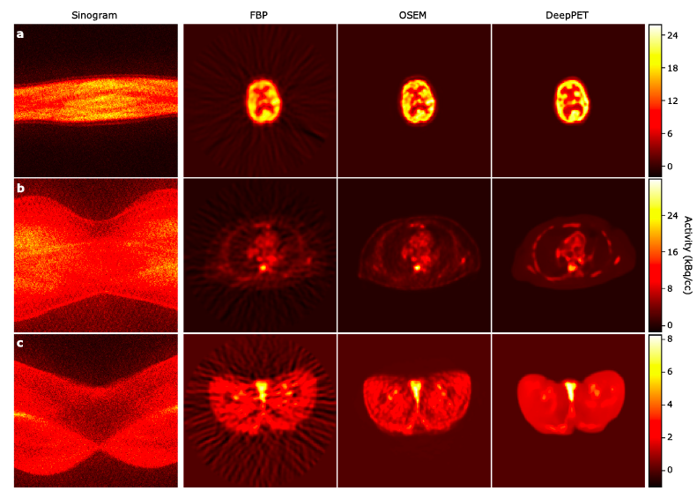
Visualization of Real Patient Data

Slide 12
4. Conclusion & Discussion
DeepPET could produce images with low bias and variance simultaneously.
DeepPET is much faster.
DeepPET could be applied to other modalities, like CT.
Pitfalls:
Realistic simulation data is required.
Hard to produce high resolution images with current framework.
Notes:
PETSTEP may introduce system noise and bias into training data, which may not be reflected in real patient data.
Intrinsically, deep network boosts the reconstruction performance by learning an optimal regularization term from large amounts of data.
A standard dataset is required for further developing state-of-art DL methods.

